Slide 1
Ibn Battuta A Gift to Those Who Contemplate the Wonders of Cities and the Marvels of Travelling

Slide 2
IBN Battuta
Discussion Questions
In what ways does Ibn Battuta's narrative differ from Benjamin of Tudela’s?
What draws Ibn Battuta’s interest while traveling?
What role does Islam play throughout the text?
How does Ibn Battuta respond to different cultures? In what ways is he affected or changed by them?
How do other cultures respond to Ibn Battuta? Are they also shaped by him?

Slide 3
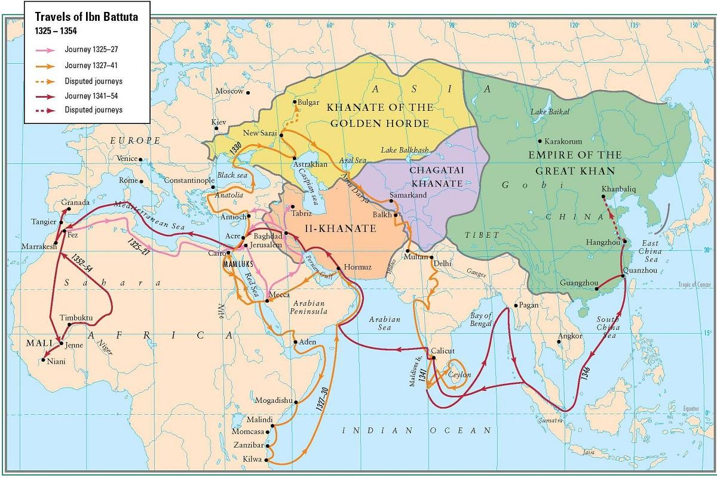
Ibn Battuta’s Itinerary

Slide 4
The Fundamental Structure of Academic Argument Continued…

Slide 5
They say . . .
I say . . .
[I = the author of the academic argument]
So what?
Notes:
Most of the pieces of academic argument can be divided into three broad categories: THEY SAY, I SAY, and SO WHAT?

Slide 6
They Say =
a persistent problem, question, or puzzle
current answer(s) to that question or problem
I Say =
shows a flaw or omission or implication in what “they say”
offers a new, better answer
So what? =
why this matters; what’s at stake
Notes:
Each of these terms stand in for a handful of ideas. Do you associate any of these ideas with other terms we’ve already used in the course?
PROBLEM/QUESTION, THESIS, MOTIVE

Slide 7
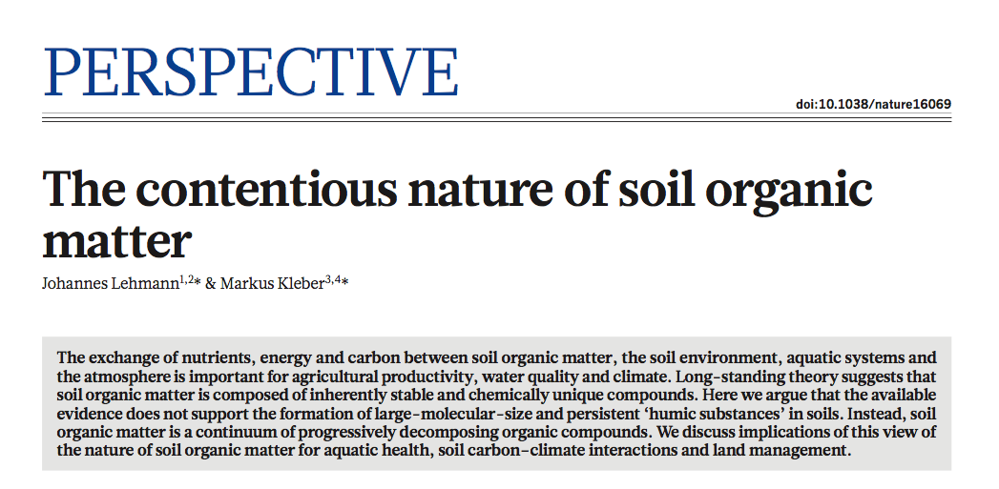
Notes:
A generic, but well-formed abstract from the science journal NATURE.

Slide 8
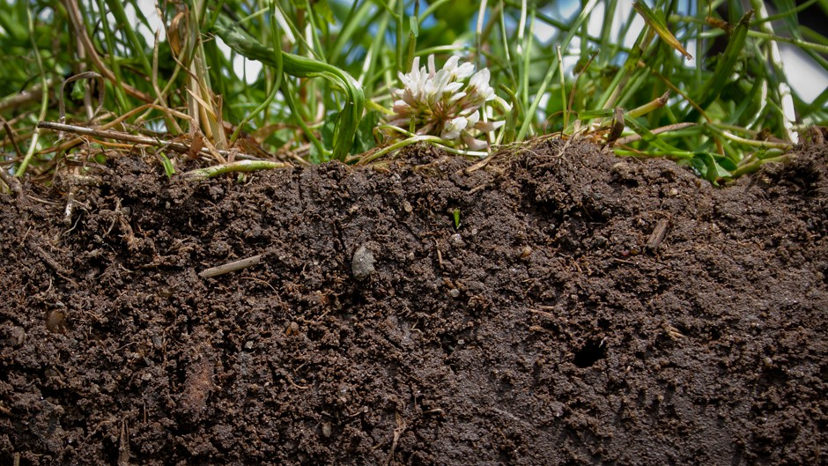
The exchange of nutrients, energy and carbon between soil organic matter, the soil environment, aquatic systems and the atmosphere is important for agricultural productivity, water quality and climate.
Long-standing theory suggests that soil organic matter is composed of inherently stable and chemically unique compounds.
Here we argue that the available evidence does not support the formation of large-molecular-size and persistent “humic substances” in soils.
Instead, soil organic matter is a continuum of progressively decomposing organic compounds.
We discuss implications of this view of the nature of soil organic matter for aquatic health, soil carbon-climate interactions and land management.
Notes:
We are looking for They Say, I Say, & So What. I’ll read the sentences out loud, and you listen for whether each sentence fits into THEY SAY, I SAY, or SO WHAT. Are there certain words that seem to indicate which category the sentence falls into?

Slide 9
The exchange of nutrients, energy and carbon between soil organic matter, the soil environment, aquatic systems and the atmosphere is important for agricultural productivity, water quality and climate.
Long-standing theory suggests that soil organic matter is composed of inherently stable and chemically unique compounds.
Here we argue that the available evidence does not support the formation of large-molecular-size and persistent “humic substances” in soils.
Instead, soil organic matter is a continuum of progressively decomposing organic compounds.
We discuss implications of this view of the nature of soil organic matter for aquatic health, soil carbon-climate interactions and land management.
Notes:
YEP, here are those words

Slide 10
Fundamental Structure of Academic Argument: 5 Elements
Problem
Established View
Flaw
Thesis
Motive
--Will Evans, “‘The Elements’ of Hopkins Expos”
Notes:
These are the five elements that are common to academic argument in every discipline. Some of them you are already familiar with.

Slide 11
They Say
Problem
Established View (EV)
An ongoing, persistent problem or question—something that is difficult to understand.
Flag words: explore, raise questions about
A voice in the ongoing conversation about the problem. A proposed solution to the problem.
Flag words: widely believed, some have argued

Slide 12
I Say
Flaw
Thesis
Some concern that the author raises about the validity of the EV. The essay points to a flaw/flaws in the logic of the EV, or in the EV’s use of evidence, or in the assumptions the EV makes, or the implications of the EV.
Flag words: however, but, yet.
The author corrects the flaw in the EV; it offers a new, better view in place of the original EV.
Flag words: instead, rather, therefore.

Slide 13
So what?
Motive
Tells the reader why any of this matters in the first place. Answers the questions So what? and What’s at stake? Signaled by phrases that direct us outward toward a larger, more important topic, something larger at stake—ethical implications, for instance.
Flag words: important to consider, significant.

Slide 14
Elements of Academic Argument
Problem
Established View
Flaw
Thesis
Motive
something difficult to understand; an ongoing conversation/question
a voice in the conversation; a proposed solution/answer
a concern about the EV’s validity
correction of the flaw; a better view; the product of the analysis
why this is important?; what’s at stake?; so what?
Notes:
The Five Elements in sum. Where do you see each of these elements in the sample abstract that I’ve handed out to you?

